Slide 1




RNASeq Analysis Workshop
Nov. 5-7, 2020 Florida International University
Nov. 12-14, 2020 University of Puerto Rico
Nov. 19-21, 2020 University of Puerto Rico
Instructor
Ravi Kiran Donthu, Ph.D.
Sponsors
Puerto Rico Science, Technology and Research Trust
Department of Biology, University of Puerto Rico
Institute of Environment, NSF CREST Center for Aquatic Chemistry and Environment
National Science Foundation (NSF)
Puerto Rico
Science, Technology
& Research Trust
UPR - Department of Biology
College of Natural Resource
Río Piedras Campus
Notes:
Include emblems for sponsors from the website at the bottom of the page

Slide 2
Data Pre-processing
Day 1
[Session 2]
Notes:
Put same

Slide 3
Login to FIU cluster
Please follow these steps to login to the FIU server
  Instructor will assign a node to each participant
  Ssh to wolf cluster (wolf.cs.fiu.edu)
  From wolf ssh to bioinfo nodes (bioinfo-01 to bioinfo-08)
Go to workshop website and download the slide presentation for Day1
Scripts necessary for the steps we will learn today will be found in the slide presentation
Please open presentation so that we can obtain necessary information to run workshop exercises

Slide 4
Directory structure for the workshop
Create a workshop folder
Create sub folders
  data – to place all data files
  Src – to save all scripts
  Results – to save results from different analysis
Linux commands:
cd ~
mkdir workshop_RNASeq_2020
cd workshop_RNASeq_2020
mkdir data src results

Slide 5
Workshop dataset to be used for analysis
Honeybee RNASeq experiment
Controls (workers from colonies with open brood and uncaged queen) – 3 Reps
Treatments (workers from colonies with no open brood and caged queen) – 3 Reps
Illumina Paired end dataset
Read length 100 bp
Number of reads – 100,000
Download from the workshop website to the data folder inside the workshop folder
cd ~/workshop_RNASeq_2020/data
wget path/to/data/on/workshop
unzip data.zip

Slide 6
Overview of RNASeq analysis workflow
Reads
Alignment to reference genome
Gene/Transcript abundance
Differentially expressed genes/transcripts

Slide 7
Quality Control of FASTQ files
Reads
Quality check
Alignment to reference genome
Gene/Transcript abundance
Differentially expressed genes/transcripts

Slide 8
Run FastQC
Two ways to run FastQC:
  1. Interactive mode
  2. Submitting a script
Interactive mode:
cd ../results/
mkdir fastqc_results_Nov2020
cd fastqc_results_Nov2020
fastqc ../../data/C4-45-2_1_100K.fq
fastqc --help

Slide 9
FastQC script
Header of the script
#!/bin/bash # run it as bash script
#SBATCH -N 1 # Number of nodes to reserve
#SBATCH -n 1 # Number of processors per node to reserve
#SBATCH --nodelist=bioinfo-04 # Which node to run the script
#SBATCH --mail-user youremail@address.edu
#SBATCH --mail-type BEGIN,END,FAIL
#SBATCH -J qc # job name
#SBATCH --output=fastqc-%a.out #standard output file name
#SBATCH -D /lclhome/rdonthu/Workshop_RNASeq/src/slurm-out #outdir

Slide 10
FastQC script
Body of the script
cd $SLURM_SUBMIT_DIR # changes directory to ~/workshop_RNASeq_2020/src
# Command that runs fastqc
fastqc ../data/C4-45-2_1_100K.fq -o ../results/2020-03-02-fastqc

Slide 11
Full FastQC script for one sample
#!/bin/bash # run it as bash script
#SBATCH -N 1 # Number of nodes to reserve
#SBATCH -n 1 # Number of processors per node to reserve
#SBATCH --nodelist=bioinfo-04 # Which node to run the script
#SBATCH --mail-user youremail@address.edu
#SBATCH --mail-type BEGIN,END,FAIL
#SBATCH -J qc # job name
#SBATCH --output=fastqc-%a.out #standard output file name
#SBATCH -D /lclhome/rdonthu/Workshop_RNASeq/src/slurm-out #outdir
cd $SLURM_SUBMIT_DIR # changes directory to ~/workshop_RNASeq_2020/src
# Command that runs fastqc
fastqc ../data/C4-45-2_1_100K.fq -o ../results/2020-03-02-fastqc

Slide 12
Submit the script
sbatch fastqc.sh
To check Job status:
squeue –u username

Slide 13
What if I have 50 samples and 100 files?

Slide 14
To submit job for multiple samples
cd $SLURM_SUBMIT_DIR # changes directory to ~/workshop_RNASeq_2020/src
filename=$(sed -n -e "$SLURM_ARRAY_TASK_ID p" ../data/samples.txt)
fastqc ../data/${filename}_1_100K.fq -o ../results/2020-03-02-fastqc
sbatch –-array 1-6 fastqc.sh

Slide 15
Advantages of submitting job script
Easy to run multiple samples
Use cluster resources only for the required amount of time
Setup a workflow of analysis
Easy way to document our work

Slide 16
Command that shows list of available parameters associated with running fastqc in order to improve the quality of data, input and outputs options
fastqc --help
When you have lots of samples to run it is useful to have parameter(s) that help increase the speed of the job
-t or --threads

Slide 17
Rerun fastqc script
Please go to the previous fastqc script
Modify it to include --threads option
Rerun it so that it generates output in a new folder within results folder
Let me know if you have any questions

Slide 18
Steps to download fastqc summary report (html) file
1.rsync C4-45-2_1_100K_fastqc.html rdonthu@wolf.cs.fiu.edu:
2.Use mobaxterm sftp window to download to your laptop

Slide 19
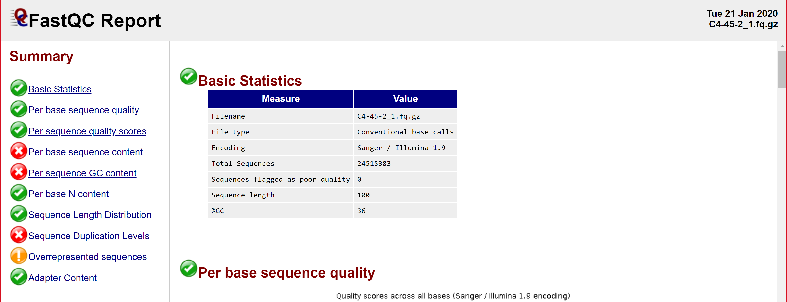
FastQC summary report

Slide 20
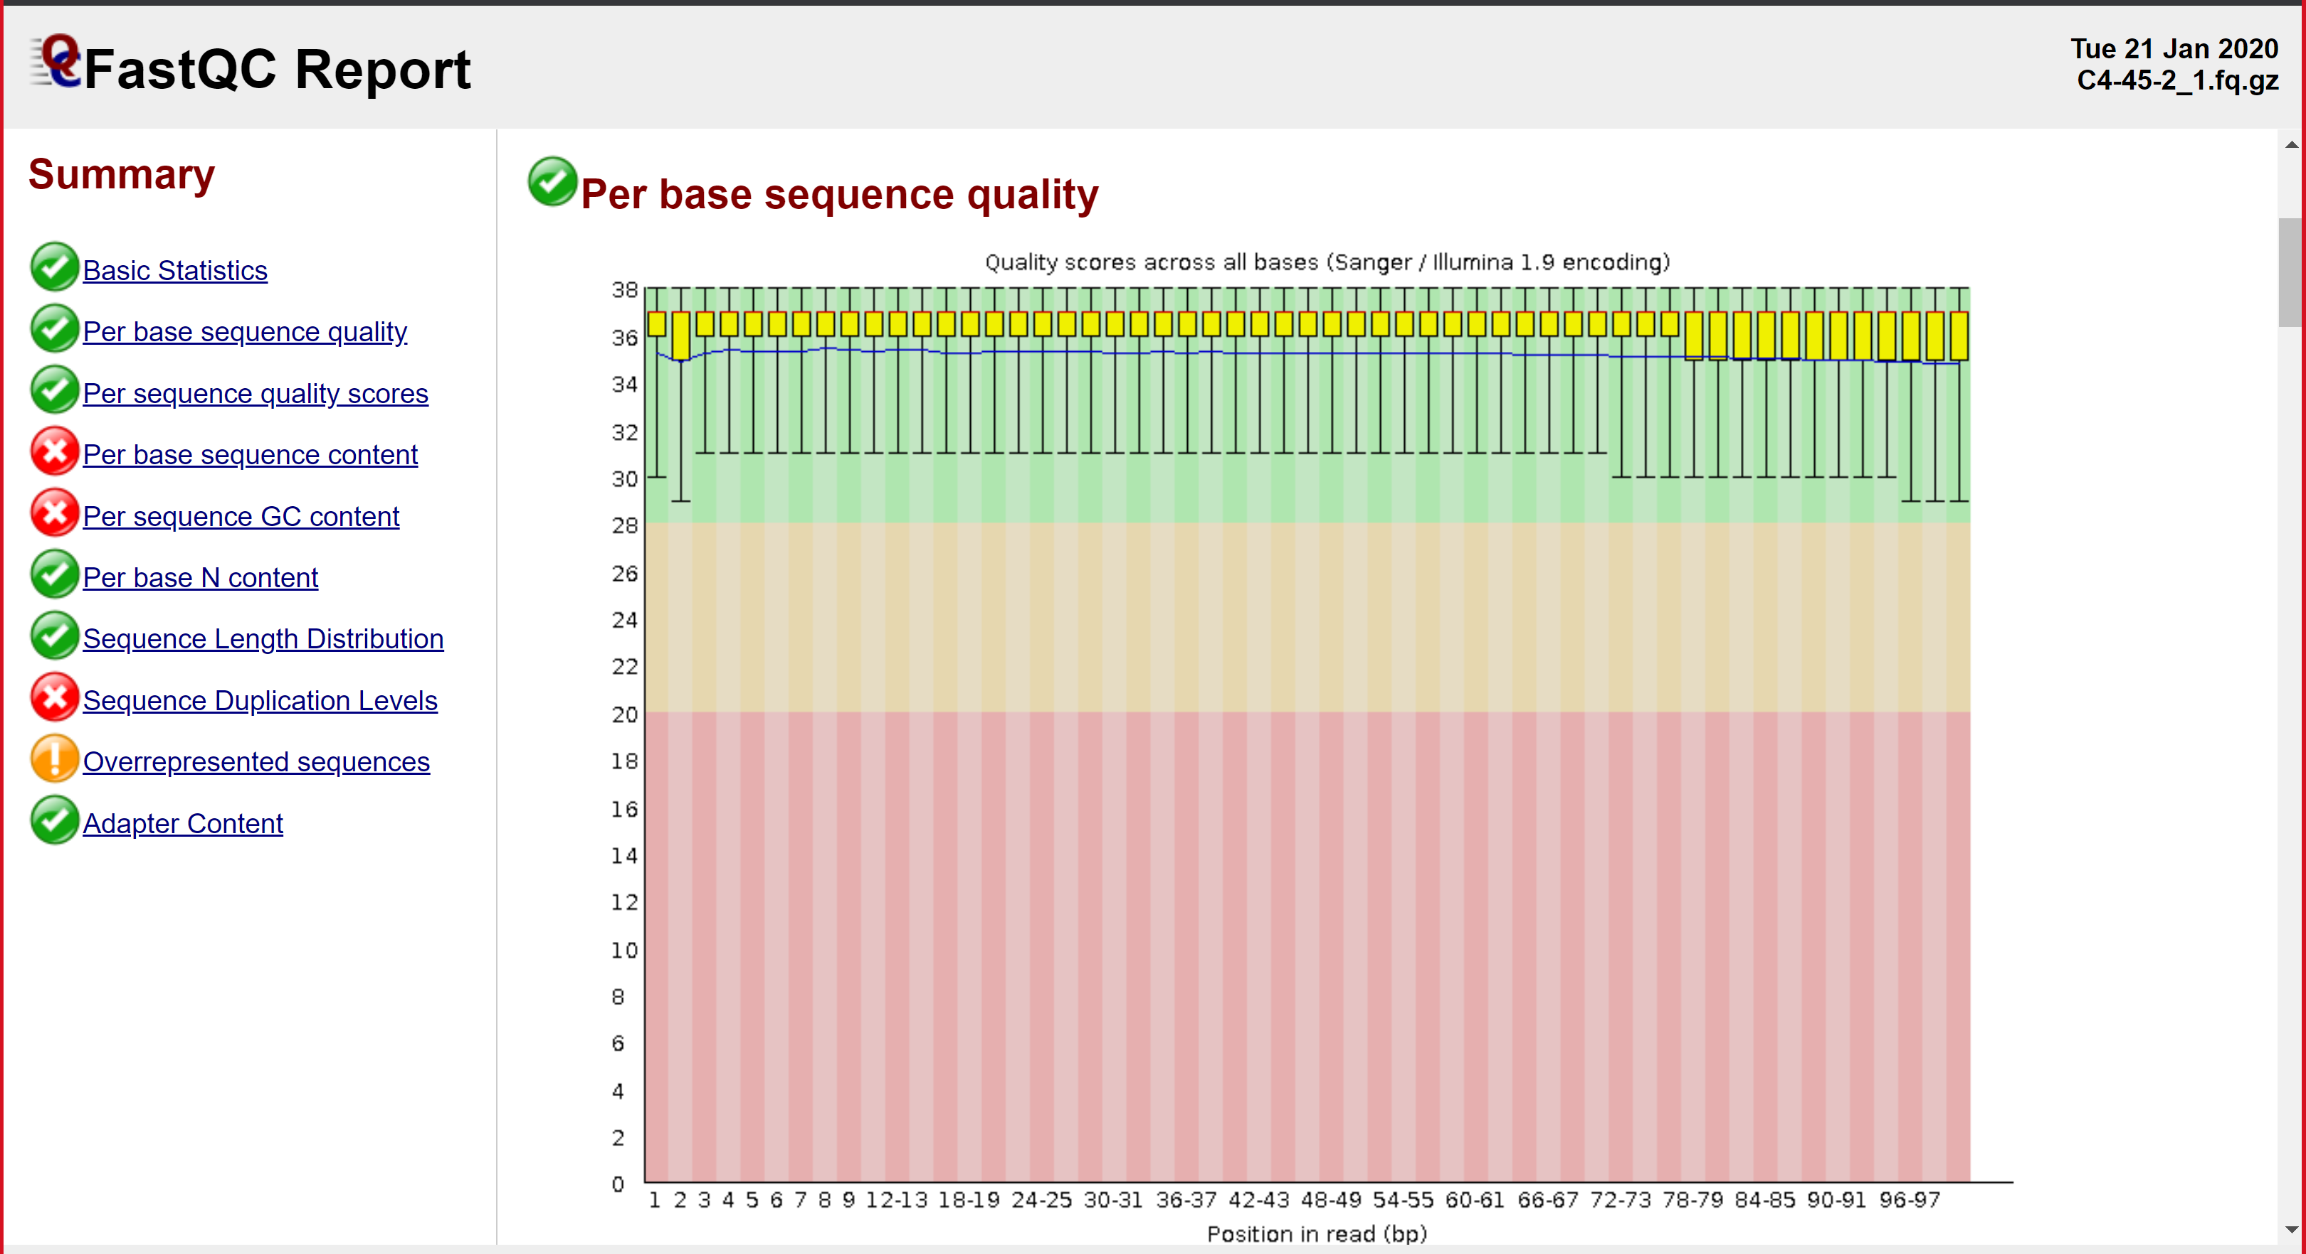
Per Base Sequence Quality

Slide 21
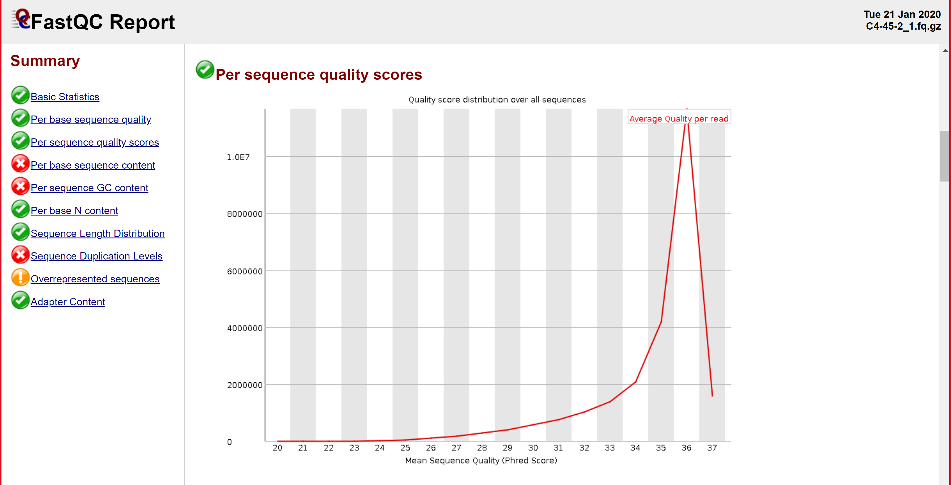
Per Sequence Quality Score

Slide 22
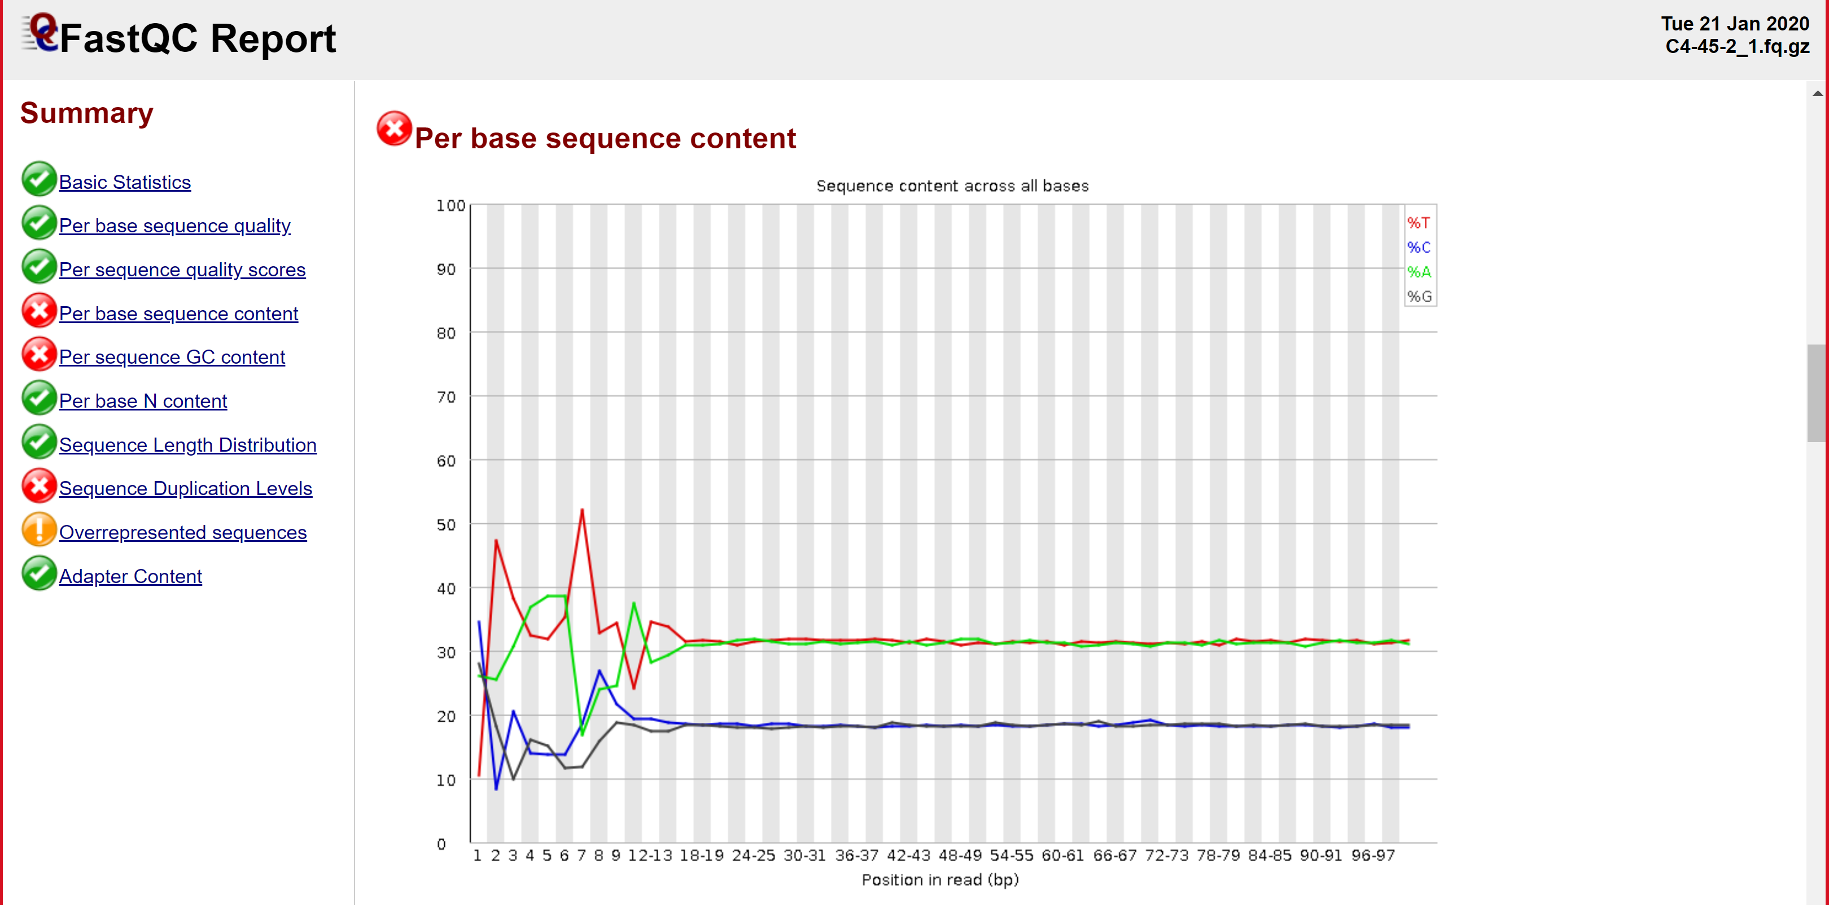
Per Base Sequence Content

Slide 23
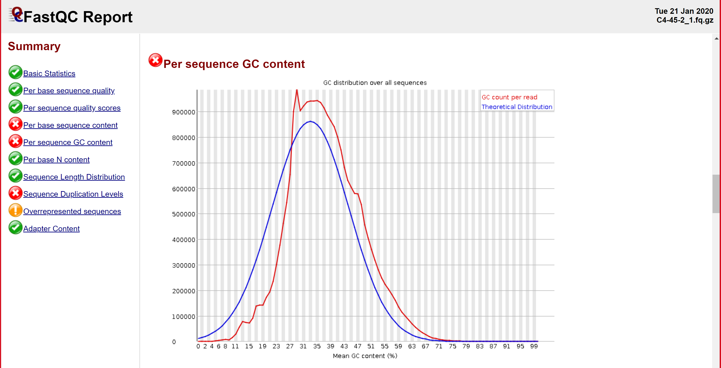
Per Sequence GC Content

Slide 24
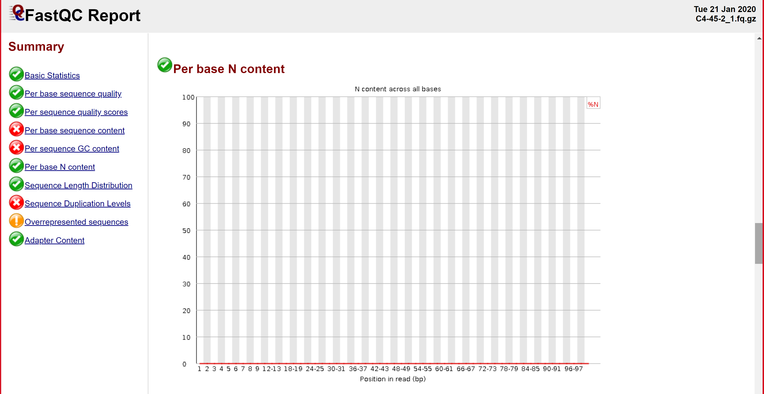
Per Base N Content

Slide 25
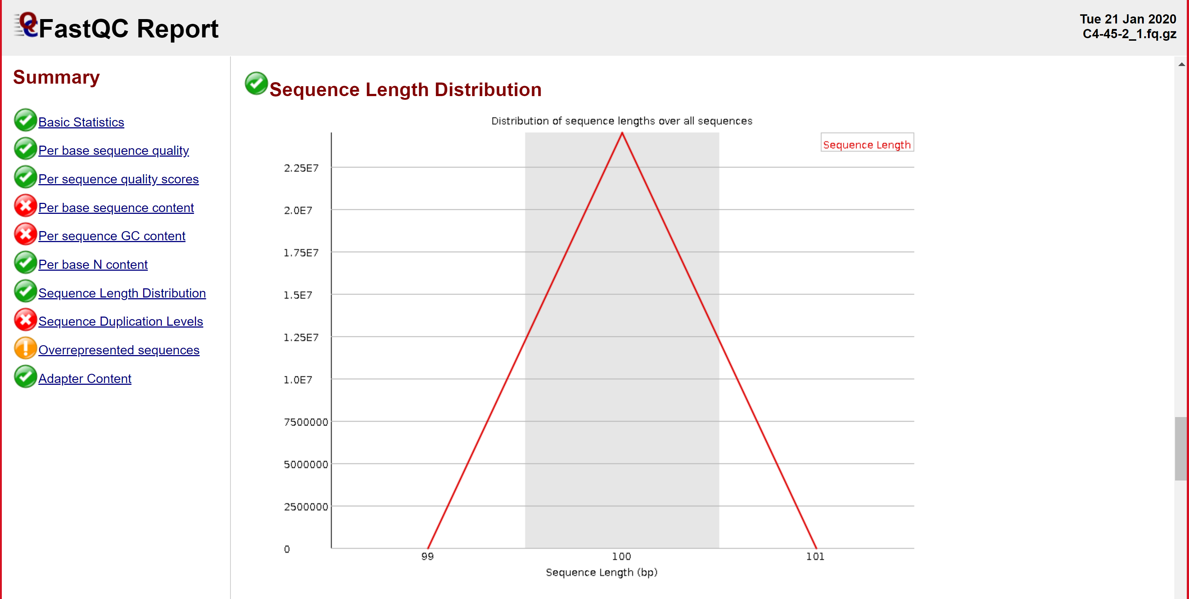
Sequence Length Distribution

Slide 26
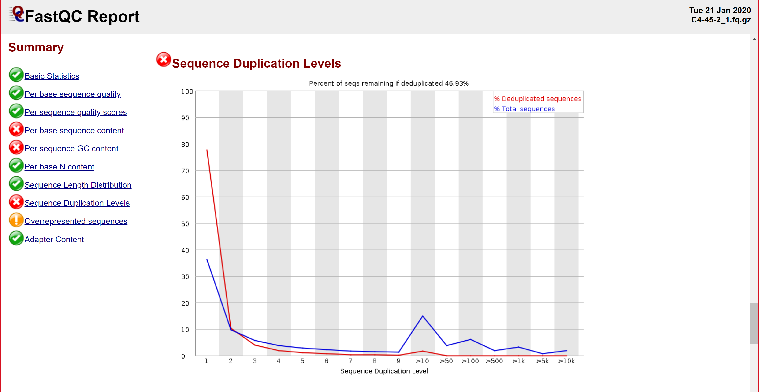

Slide 27
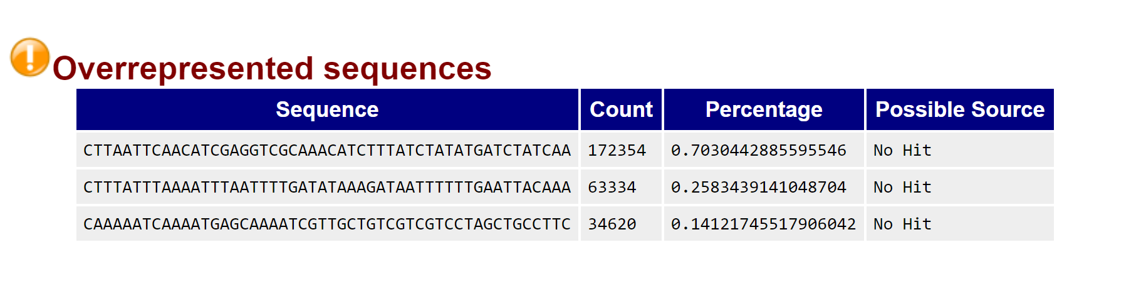

Slide 28
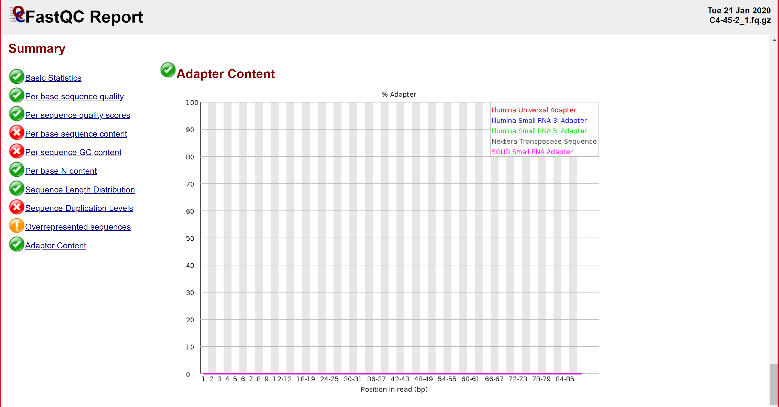
Adapter Content

Slide 29

MultiQC – Summary for Multiple Samples

Slide 30
Running MultiQC
Open linux terminal on bioinfo node and type the multiqc command that displays the help manual
multiqc --help
Take a look at all the available options and their functions
Open the previous fastqc script into a text editor (nano)
Change directory to folder where fastqc output files are located
cd $SLURM_SUBMIT_DIR/../results/fastqc_results
Replace fastqc command with the following command
multiqc

Slide 31
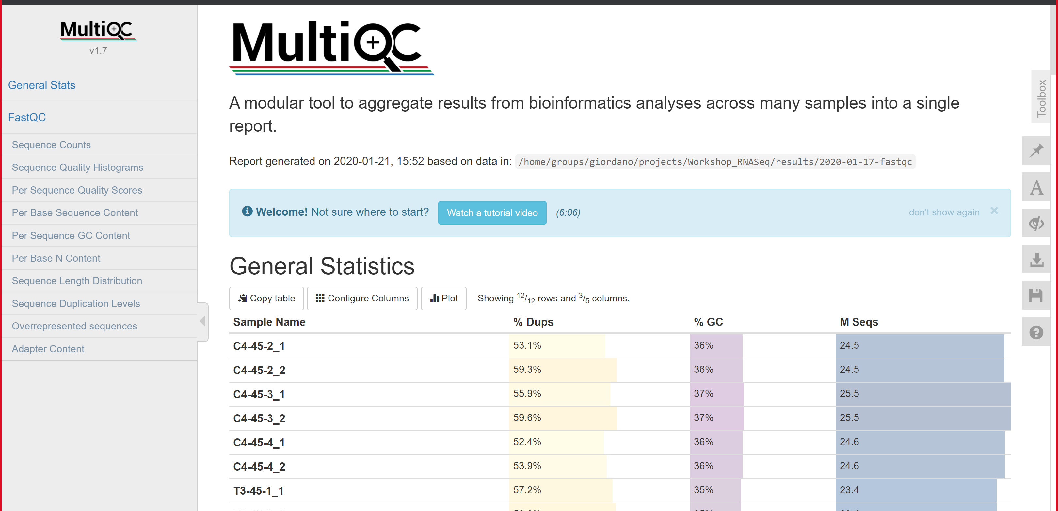
MultiQC General Stats

Slide 32
FASTQ format
Our first goal is to identify low quality bases in reads and trim them

Slide 33

Trim reads
  Why?
    To remove sequence that isn’t:
      real
      biological
      useful
  What?
    Adapter sequences
    Low quality bases
    Short reads (leftover from trimming)
  How?
    Trimmomatic (most commonly used)
    BBDuk (provides greater control over trimming options)
    FASTX-toolkit (includes many other handy tools as well)
ATGTTGCCTACA
U of Illinois – High-Performance Biological Computing
Notes:
Remove the blue band with the U of Illinois info just add the following at the lower right corner
U of Illinois – High-Performance Biological Computing

Slide 34
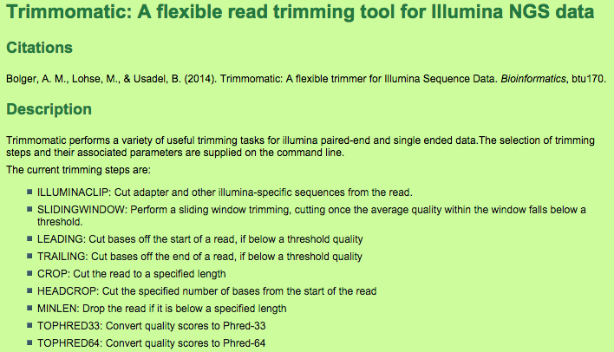
Trimming with Trimmomatic
http://www.usadellab.org/cms/?page=trimmomatic

Slide 35
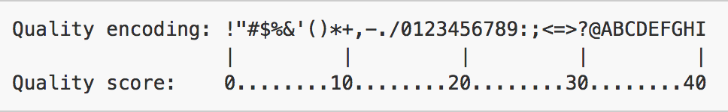
Example - TRAILING:30
Trim off end of sequence until the quality score is above 30. See the key below for quality encoding information. To trim, simply delete the poor quality base calls, or color them in red.
@ | M | y | S | e | q | 1
A | G | G | C | T | T | T | A | C | T | A | T | G | G | A | G | C | T | C | T | A | C | G
+
H | H | G | G | G | G | F | F | E | D | D | C | C | B | A | @ | ; | < | 8 | 0 | . | + | #
Quality Score Key:
U of Illinois – High-Performance Biological Computing
Notes:
Make red line around box thicker as the others

Slide 36

Command for Trimming with Trimmomatic
http://www.usadellab.org/cms/?page=trimmomatic
Notes:
Can we get rid of the green background and just frame the content in red boxes as the other slides

Slide 37
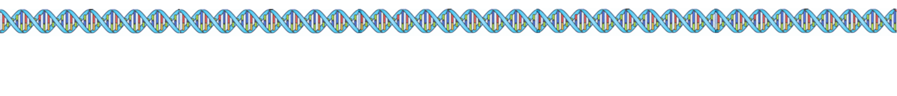
Exercise - ILLUMINACLIP
Find the adapter sequence, then trim off this adapter sequence and anything following it. To trim, simply delete the offending base calls, or color them in red.
>seq1 my adapter sequence
GGAGCTCTA
@ | M | y | S | e | q | 1
A | G | G | C | T | T | T | A | C | T | A | T | G | G | A | G | C | T | C | T | A | C | G
+
H | H | G | G | G | G | F | F | E | D | D | C | C | B | A | @ | ; | < | 8 | 0 | . | + | #
U of Illinois – High-Performance Biological Computing

Slide 38
Dataset for trimming using trimmomatic
AGS3_R1_100K.fq
AGS3_R2_100K.fq

Slide 39
Script to run Trimmomatic
#!/bin/bash
#SBATCH -N 1
#SBATCH -n 1
#SBATCH --nodelist=bioinfo-04
#SBATCH --mail-user username@email.edu
#SBATCH --mail-type BEGIN,END,FAIL
#SBATCH -J trim
#SBATCH --output=trimmomatic.out
#SBATCH -D /lclhome/rdonthu/Workshop_RNASeq/src/slurm-out
cd $SLURM_SUBMIT_DIR
TrimmomaticPE \
../data/AGS3_R1_100K.fq \
../data/AGS3_R2_100K.fq \
../results/2020-10-26-trimmomatic/AGS3_R1.trim.fastq \
../results/2020-10-26-trimmomatic/AGS3_R1.trim.unpaired.fastq \
../results/2020-10-26-trimmomatic/AGS3_R2.trim.fastq \
../results/2020-10-26-trimmomatic/AGS3_R2.trim.unpaired.fastq \
ILLUMINACLIP:../data/TruSeq3-PE-2.fa:2:15:10 LEADING:30 TRAILING:30 SLIDINGWINDOW:4:15 MINLEN:30

Slide 40
Edit trimmomatic script
  Change the email address to yours
  Add an extra command at the bottom that will run FASTQC on the resulting trimmed file and send output to fastqc-trimseq/ in ~/workshop_RNASeq/results folder
  mkdir ../results/fastqc-trimseq
  fastqc ../results/2020-10-26-trimmomatic/AGS3_R1.trim.fastq –o../results/fastqc-trimseq
  fastqc ../results/2020-10-26-trimmomatic/AGS3_R2.trim.fastq –o../results/fastqc-trimseq
  Submit the job on the node you are running
U of Illinois – High-Performance Biological Computing

Slide 41
Run multiqc on trimmed files in interactive mode
  cd ~/Workshop_rnaseq/results/2020-10-26-trimmomatic
  multiqc .

Slide 42
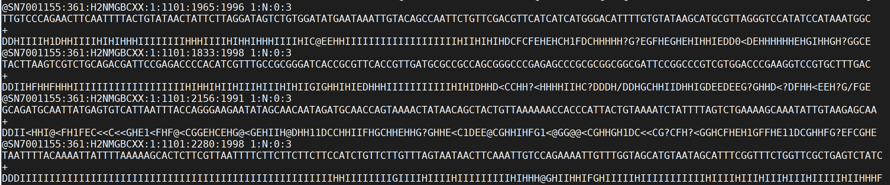
Trimmomatic output example
  Check SLURM job output files
  Check for new output files in fastqc-trimseq/ and trimmomatic/

Slide 43
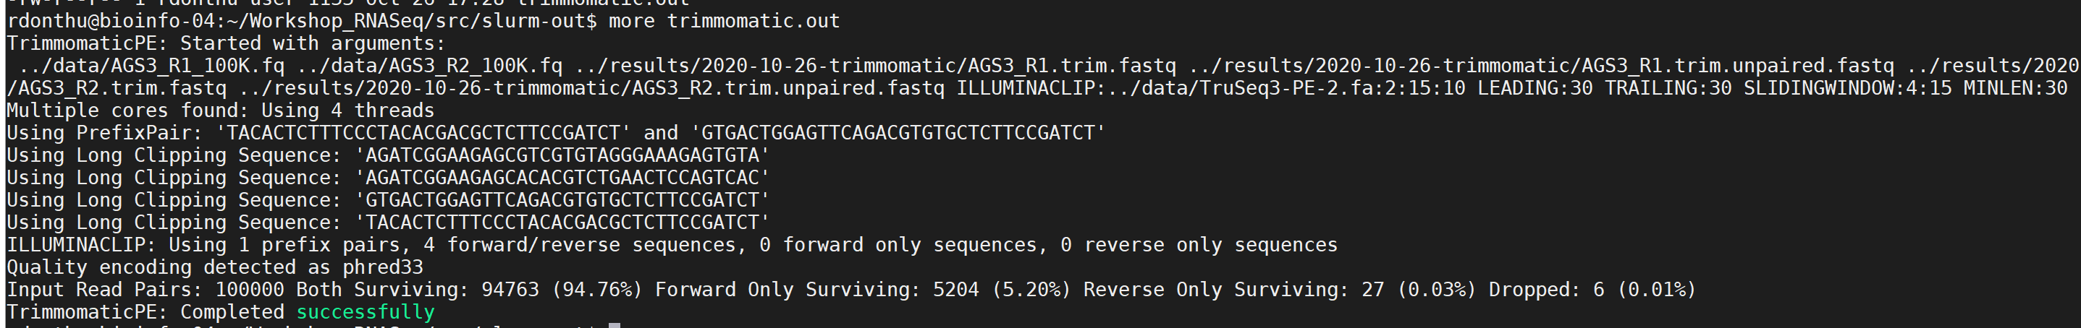
Trimmomatic SLURM output

Slide 44
Summary day 1 accomplishments
Introduction to RNASeq analysis
Data quality check using FastQC
Summary of FastQC reports using MultiQC
Trimming of low quality and adapter bases using trimmomatic

