Slide 1




RNASeq Analysis Workshop
Nov. 5-7, 2020 Florida International University
Nov. 12-14, 2020 University of Puerto Rico
Nov. 19-21, 2020 University of Puerto Rico
Instructor
Ravi Kiran Donthu, Ph.D.
Sponsors
Puerto Rico Science, Technology and Research Trust
Department of Biology, University of Puerto Rico
Institute of Environment, NSF CREST Center for Aquatic Chemistry and Environment
National Science Foundation (NSF)
Puerto Rico
Science, Technology
& Research Trust
UPR - Department of Biology
College of Natural Resource
Río Piedras Campus

Slide 2
Read alignments and
Gene abundance
Day 2
Notes:
Put same

Slide 3
Goals for the day
Download reference genome and gene annotation files
Alignment of reads against reference genome
Generating read counts for all genes
Learn to write SLURM scripts and unix commands to accomplish the above tasks

Slide 4
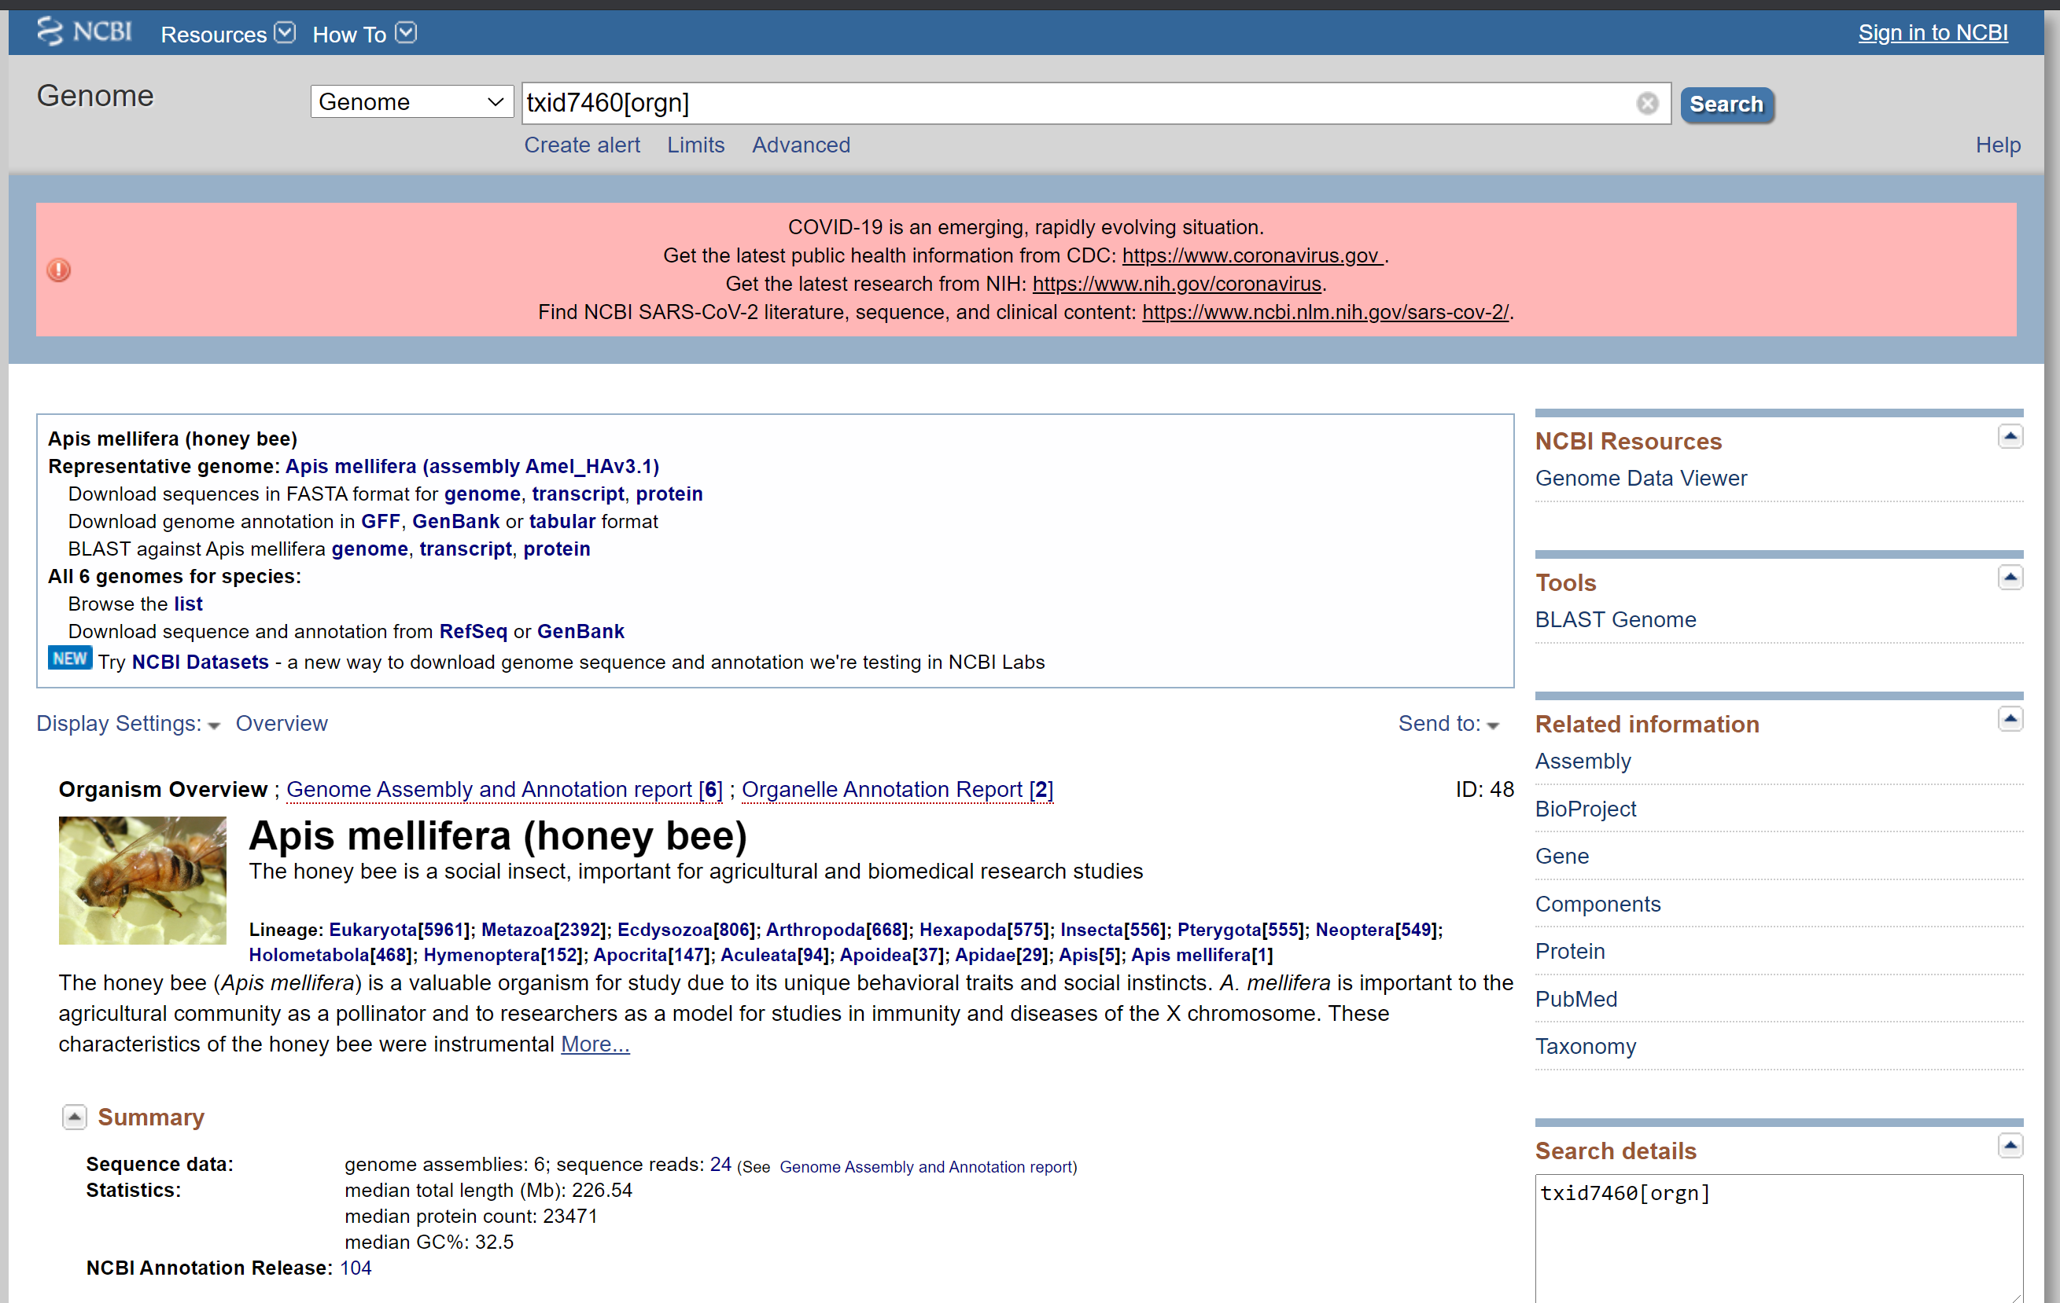
Reference genome

Slide 5
Download Exercise
Create a folder “genome” inside data folder of the workshop folder
Use wget command to download to the “genome” folder
  FASTA file of honey bee reference genome version Amel_HAv3.1 from NCBI
  Gene annotation file in GFF format
  Transcript sequences in fasta format
  Protein sequences in fasta format
  Can anyone figure out the link to download the gene annotation file in GTF format?

Slide 6
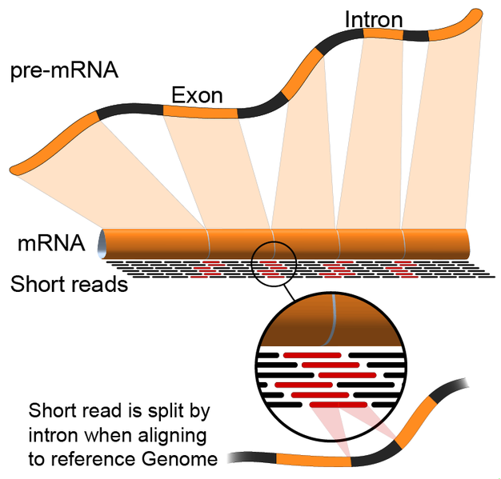
RNASeq alignment

Slide 7
Short read aligners
Splice aware aligners:
    STAR, TopHat2, HISAT2
    Align against eukaryote genomes
Splice unaware aligners:
    BWA, Bowtie
    Align against transcriptome
    Align against prokaryote genomes

Slide 8
STAR (2.5.2a)
Underlying algorithm allows it to outperform other aligners in speed by more than 50x
Splice-aware - can discover de novo splice junctions
STAR prefers GTF feature format
  Accepts GFF3, but does not work correctly in our experience
STAR has a counting option
  Default values of htseqcount (can’t change option values)
Paper: http://bioinformatics.oxfordjournals.org/content/early/2012/10/25/bioinformatics.bts635
GitHub page: https://github.com/alexdobin/STAR
  Make sure defaults are okay for your organism and your GTF (see parameters near end of manual)!
U of Illinois – High-Performance Biological Computing

Slide 9
What is required to run alignments?
Reference genome sequence in FASTA format
Indexing the genome sequence
High quality trimmed reads in fastq format
Gene annotation file
Output folder to save the output alignments

Slide 10
Genome Index
All alignment programs require a genome index file to be generated
    An index is similar to having a table of contents for your genome
    These index files are usually specific to the software that generates them
STAR uses a different index & the format differs between pre- and post- version 2.4.2a.
    mouse and human are available on STAR’s github
  Will need to make your own index file if one is not available
U of Illinois – High-Performance Biological Computing

Slide 11
Download STAR manual
https://github.com/alexdobin/STAR/blob/master/doc/STARmanual.pdf

Slide 12
STAR genome index script
#!/bin/bash
#SBATCH -N 1
#SBATCH -n 1
#SBATCH --mem=15gb
#SBATCH --nodelist=bioinfo-XX
#SBATCH --mail-user email@address.edu
#SBATCH --mail-type BEGIN,END,FAIL
#SBATCH -J index
#SBATCH --output=starIndex-%a.out
#SBATCH -D /lclhome/username/Workshop_RNASeq/src/slurm-out
cd $SLURM_SUBMIT_DIR
/opt/STAR/bin/Linux_x86_64/STAR \
--runThreadN $SLURM_CPUS_ON_NODE \
--runMode genomeGenerate \
--genomeDir ../data/genome/star_index \
--genomeFastaFiles ../data/genome/GCF_003254395.2_Amel_HAv3.1_genomic.fna \
--sjdbGTFfile ../data/genome/GCF_003254395.2_Amel_HAv3.1_genomic.gtf \
--sjdbOverhang 99
U of Illinois – High-Performance Biological Computing

Slide 13
In STAR manual, 3 options listed for running alignment
--runThreadN – Number of threads
--genomeDir – path to genome directory
--readFilesIn – path to read files
Create a star alignment job script using these 3 basic options listed above

Slide 14
Star alignment script using 3 basic options
#!/bin/bash
#SBATCH -N 1
#SBATCH -n 1
#SBATCH --mem=15gb
#SBATCH --nodelist=bioinfo-04
#SBATCH --mail-user email@address.edu
#SBATCH --mail-type BEGIN,END,FAIL
#SBATCH -J align
#SBATCH --output=starBasicOne-%a.out
#SBATCH -D /lclhome/username/Workshop_RNASeq/src/slurm-out
cd $SLURM_SUBMIT_DIR
/opt/STAR/bin/Linux_x86_64/STAR \
--runThreadN $SLURM_NTASKS \
--genomeDir ../data/genome/star_index \
--readFilesIn ../data/C4-45-3_1_100K.fq ../data/C4-45-3_2_100K.fq

Slide 15
Browse the output files generated
Log files:
  Log.out
  Log.final.out
  Log.progress.out
SAM Output file:
  Alignment.out.sam

Slide 16
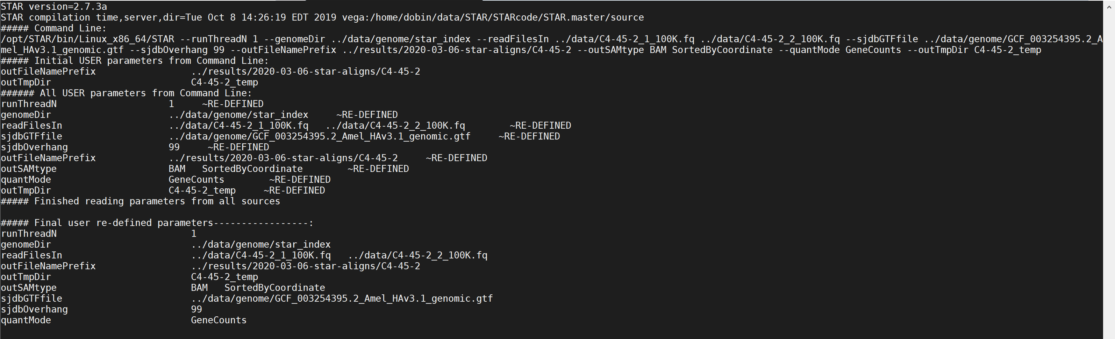
Browse the output files generated
Log files:
  Log.out

Slide 17
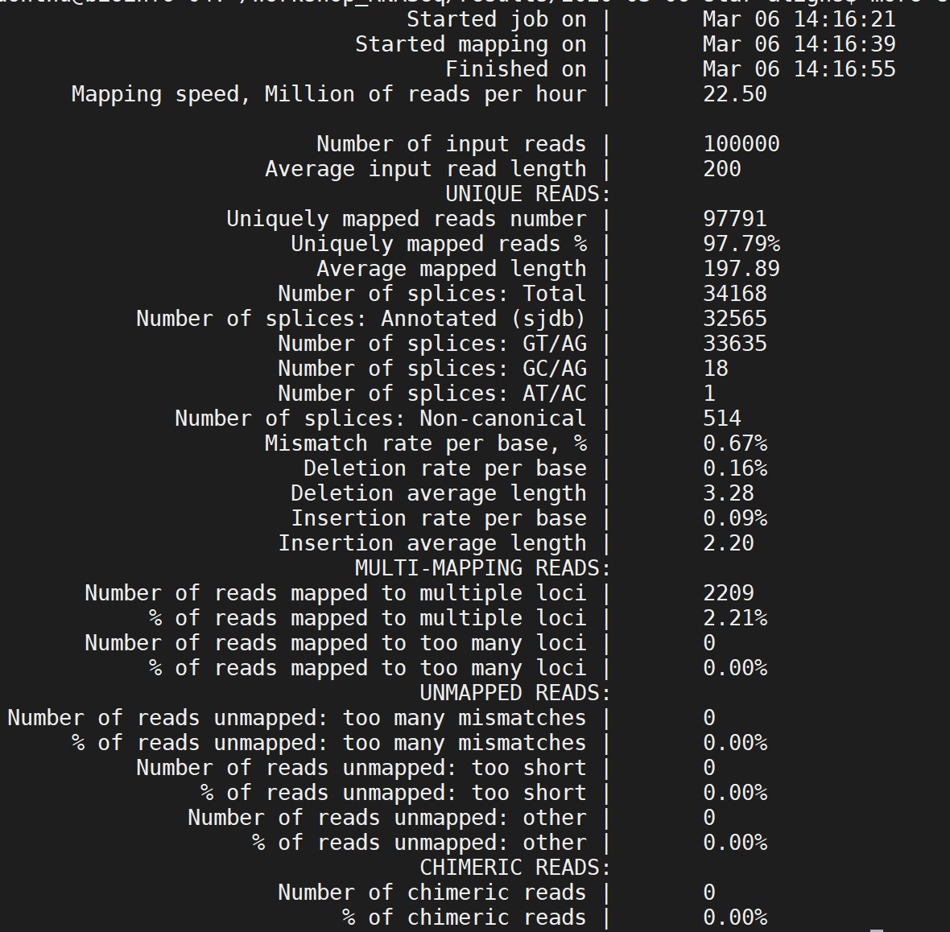
Browse the output files generated
Log.final.out - summary of alignment statistics
Including:
Number of input reads
Number of uniquely mapped reads
Number of multiply mapped reads

Slide 18
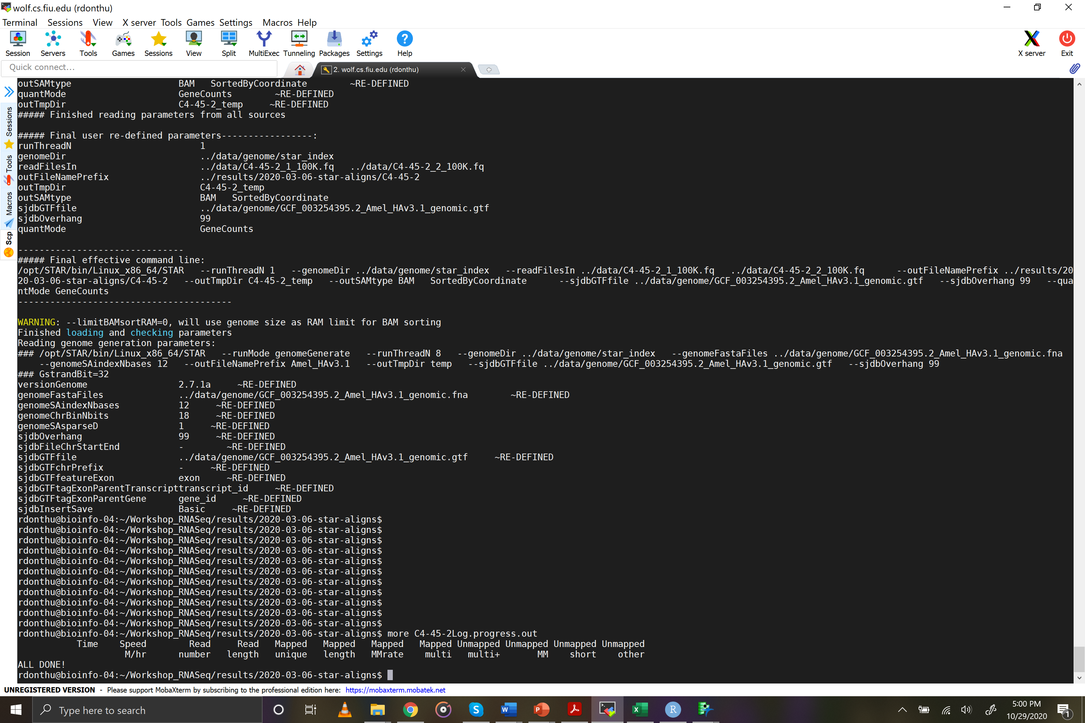
Browse the output files generated
Log files:
  Log.progress.out

Slide 19
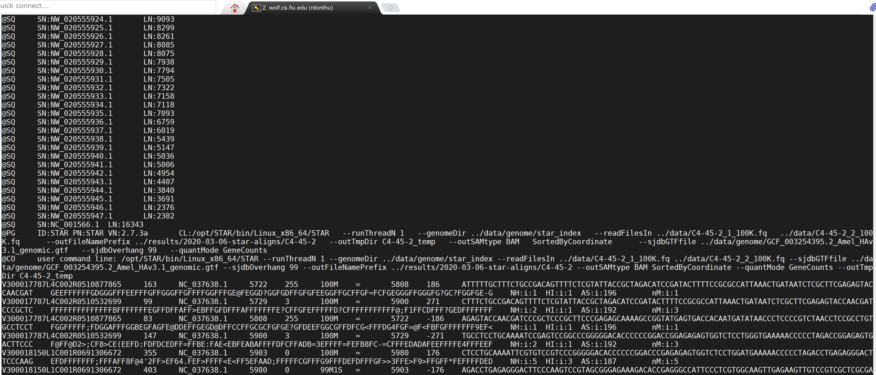
Browse the output files generated
SAM Output file:
  Alignment.out.sam

Slide 20
Steps to improve organization of the previously generated files
Redirect output to results folder
Add sample name to output files
Sort the output file based on genome coordinates of alignments
Convert SAM to BAM to reduce the file size
Run with gene annotation file
Use one script to run STAR on multiple samples

Slide 21
Steps to improve organization of the previously generated files
Redirect output to results folder --outFileNamePrefix
Add sample name to output files --outFileNamePrefix
Convert SAM to BAM to reduce the file size --outSAMtype BAM
Sort the output file based on genome coordinates of alignments --outSAMtype BAM SortedByCoordinate
Run with gene annotation file –sjdbGTFfile
Use one script to run STAR on multiple samples
filename=$(sed -n -e "$SLURM_ARRAY_TASK_ID p" ../data/samples.txt)--readFilesIn ../data/${filename}_1_100K.fq ../data/${filename}_2_100K.fq

Slide 22
STAR alignment script with all previously listed options
#!/bin/bash
#SBATCH -N 1
#SBATCH -n 1
#SBATCH --mem=15gb
#SBATCH --nodelist=bioinfo-04
#SBATCH --mail-user email@address.com
#SBATCH --mail-type BEGIN,END,FAIL
#SBATCH -J align
#SBATCH --output=starAlignCountsMulti-%a.out
#SBATCH -D /lclhome/username/Workshop_RNASeq/src/slurm-out
cd $SLURM_SUBMIT_DIR
filename=$(sed -n -e "$SLURM_ARRAY_TASK_ID p" ../data/samples.txt)
/opt/STAR/bin/Linux_x86_64/STAR \
--runThreadN $SLURM_NTASKS \
--genomeDir ../data/genome/star_index \
--readFilesIn ../data/${filename}_1_100K.fq ../data/${filename}_2_100K.fq \
--sjdbGTFfile ../data/genome/GCF_003254395.2_Amel_HAv3.1_genomic.gtf \
--sjdbOverhang 99 \
--outFileNamePrefix ../results/2020-10-30-star-aligns/${filename} \
--outSAMtype BAM SortedByCoordinate \
--outTmpDir ${filename}_temp

Slide 23
Overview of RNASeq analysis workflow
Reads
What we accomplished?
  We aligned reads to the genome sequence
  We obtained coordinates of the genes on the genome
Next Step:
Determine number of reads that aligned to each gene/transcript?
Alignment to reference genome
Gene/Transcript abundance
Differentially expressed genes/transcripts

Slide 24
Some available programs for Gene counting
Htseq-count
featureCounts
STAR’s built-in counting option (--quantMode)
  Same as htseq-count’s default mode

Slide 25
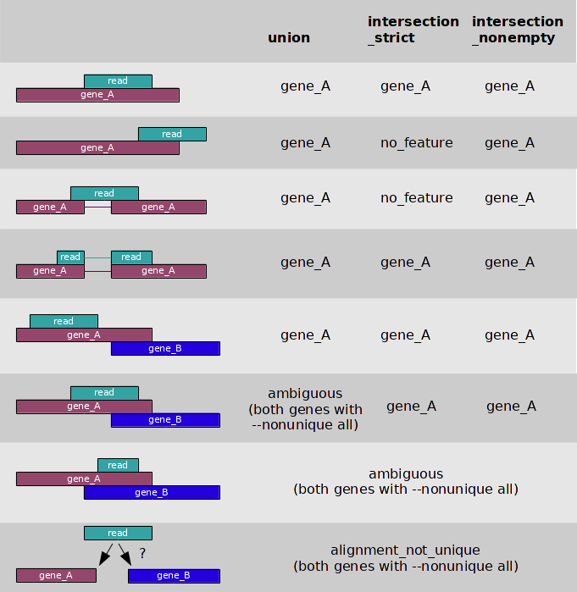
Gene counting approaches
read
gene_A
read
gene_A
read
gene_A
read
gene_A
read
read
gene_A
gene_A
read
gene_A
gene_B
read
gene_A
gene_B
gene_A
read
gene_B
read
gene_A
gene_B
Notes:
Jose can make the boxes larger

Slide 26
Gene counting with STAR
Create a new folder inside the results folder to store output files from the new STAR run
Edit the previous STAR script to add --quantMode GeneCounts
Change the output folder
Rerun STAR for all the samples

Slide 27
STAR script with GeneCounts option
#!/bin/bash
#SBATCH -N 1
#SBATCH -n 1
#SBATCH --mem=15gb
#SBATCH --nodelist=bioinfo-04
#SBATCH --mail-user email@address.edu
#SBATCH --mail-type BEGIN,END,FAIL
#SBATCH -J align
#SBATCH --output=starAlignCounts-%a.out
#SBATCH -D /lclhome/username/Workshop_RNASeq/src/slurm-out
cd $SLURM_SUBMIT_DIR
filename=$(sed -n -e "$SLURM_ARRAY_TASK_ID p" ../data/samples.txt)
/opt/STAR/bin/Linux_x86_64/STAR --runThreadN $SLURM_NTASKS \
--genomeDir ../data/genome/star_index \
--readFilesIn ../data/${filename}_1_100K.fq ../data/${filename}_2_100K.fq \
--sjdbGTFfile ../data/genome/GCF_003254395.2_Amel_HAv3.1_genomic.gtf \
--sjdbOverhang 99 \
--outFileNamePrefix ../results/2020-03-06-star-aligns/${filename} \
--outSAMtype BAM SortedByCoordinate \
--quantMode GeneCounts \
--outTmpDir ${filename}_temp

Slide 28
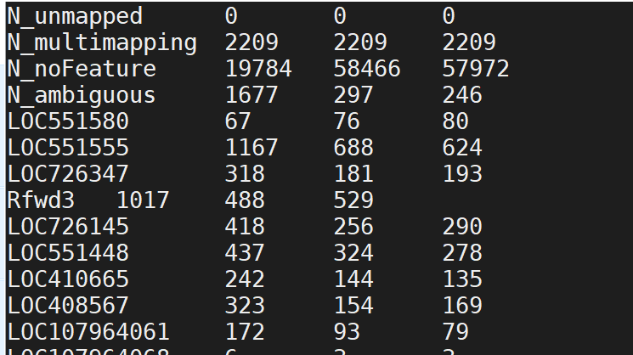
GeneCounts output
ReadsPerGene.out.tab
Column 1: gene ID
Column 2: counts for unstranded RNA-seq
Column 3: counts for the 1st read strand aligned with RNA (htseq-count option –s yes)
Column 4: counts for the 2nd read strand aligned with RNA (htseq-count option –s reverse)

Slide 29
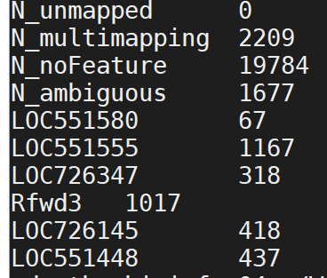
Extract counts for all samples
cd ~/workshop_rnaseq/results/star-aligns
for i in *ReadsPerGene.out.tab; do NAME=`echo "${i%%.*}"`; cut -f1,2 $i > $NAME.counts; done
### Breakdown details of the above command
for i in *ReadsPerGene.out.tab; # reads all files that ends with name ReadsPerGene.out.tab
do NAME=`echo "${i%%.*}"`; # extracts the substring that is present before the last two dots in the name
cut -f1,2 $i > $NAME.counts; # extracts the first two columns from file $i and outputs that into filename $NAME.counts

Slide 30
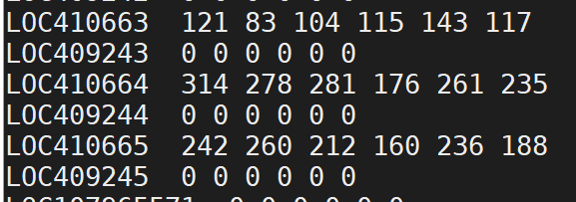
Merge counts for all samples
awk 'NF > 1{ a[$1] = a[$1] " " $2} END {for( i in a ) print i, a[i]}' *.counts >counts_allsamples.txt
Another way to do this is using R

Slide 31
Summary of today’s accomplishments
Downloading reference genome and annotation files
Alignment of reads against reference genome
Scripts to generate alignments using STAR
Script and unix commands to get read counts for all genes

